Slide 1
Organic Waste & Edible Food Capacity Planning
February 22, 2024
Robert Sedita

Slide 2
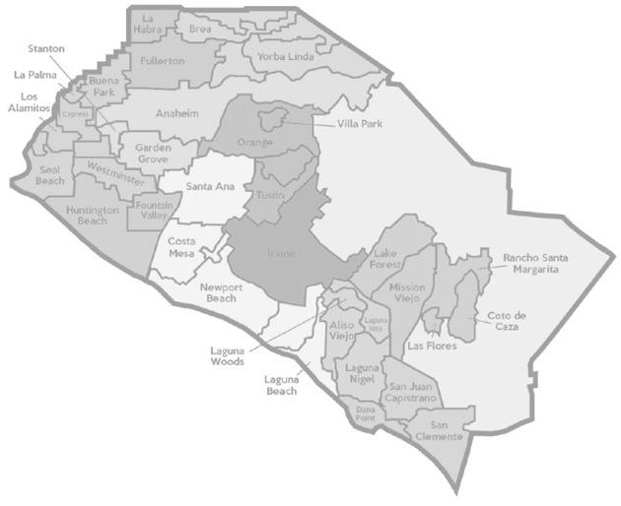
Edible Food Capacity Assessment Survey
Capacity Planning

Slide 3
Edible Food Capacity Planning
Edible Food Recovery Capacity
Estimate edible food that is recovered and disposed of by generators. Identify existing capacity available to commercial generators at edible food recovery organizations. Identify proposed new or expanded food recovery capacity. Identify the minimum capacity required to recover 20% of edible food that is estimated to be disposed.
Survey Process
A survey to collect edible food recovery capacity data was sent to each jurisdiction in the County, via the Recycling Coordinators. Tier 1 and Tier 2 commercial generators were identified using various resources including, but not limited to; County health inspector facility lists, hauler customer data, public records, business license searches, and (North American Industry Classification System (NAICs) code lists. CalRecycle’s Edible Food Recovery Capacity Calculator Tool to calculate the potential amount of edible food available for recovery.

Slide 4
Edible Food Capacity Planning
Tier 1 & 2 ​ Commercial Generators:​ | Most Donations from:​ | Fewest Donations from:​
Tier 1: 695* Generators​ | Grocery Stores, Restaurants and Schools​ | Corporate Cafeterias, Hospitals, Large Events​
Tier 2: 1,595* Generators​
Edible Food Recovery #s​ | Types of Food​
52,085,364* Lbs. ​ Food Disposed​ | Most disposed: Hot prepared foods, frozen prepared foods​
42,906,620* Lbs. ​ Edible Food RECOVERED​ | Most donated: Shelf-stable nonperishables, fresh produce, baked goods, cold refrigerated goods​
67,736,146 Lbs. | Verifiable Capacity Available to the County
10,417,073 Lbs. | County-wide Required Minimum Recovered (20%)
* Total Amounts Based Off 34 of 35 Jurisdictions

Slide 5
Capacity Planning Assessment – Food Recovery
Edible Food Capacity Planning
Capacity Assessment
28 jurisdictions reported having capacity secured.
6 jurisdictions reported having capacity but needing more.
1 jurisdiction reported not having capacity secured.
Jurisdictions requesting additional support
6 cities requested capacity building support or guidance.
All 6 are working with a consultant.
Grant Funding/Support
OCWR is assessing various ways to potentially provide assistance.

Slide 6
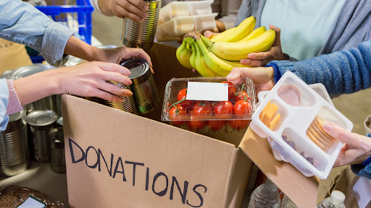
Capacity Planning Assessment – Food Recovery
Edible Food Capacity Planning
Organizations
Second Harvest
Abound Food Care
Food Finders
Helping Hands
Waste Not OC
Community Action Partners
Various Churches
Abrazar
Laguna Food Pantry

Slide 7
Organic Waste Capacity Planning
Organic Waste Recycling Capacity
Estimate the amount of organic waste in tons that will be disposed by the county and cities. Identify the amount in tons of organic waste recycling infrastructure capacity that is verifiably available. Estimate the amount of new or expanded capacity that will be necessary to process organic waste.
Survey Process
A survey to collect organic waste recycling capacity data was sent to each jurisdiction in the County, via the Recycling Coordinators.

Slide 8
Organic Waste Capacity Planning
Survey Summary
Based on jurisdiction and hauler reports, there is sufficient capacity available to the County. 35 of 35 jurisdictions, reported having verifiable organic waste recycling capacity. Jurisdictions reported using multiple facilities that provide organic waste & recycling for their jurisdictions/haulers. CR&R was been identified as a resource that has proposed expansion plans that would increase future organic waste recovery capacity available to the County.
Organic Waste Disposed | Verifiable Capacity | Verifiable Capacity Available to the County
1,079,785 tons | 35 of 35 Jurisdictions report having verifiable capacity | 6,466,375 tons

Slide 9
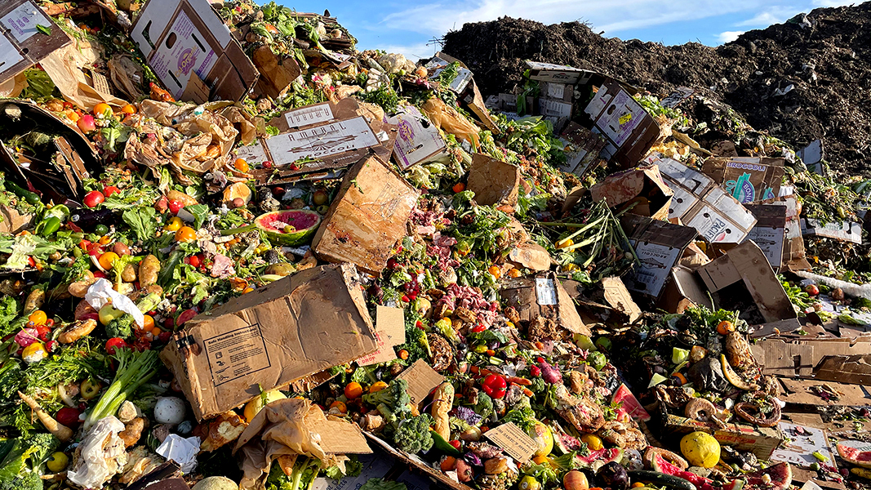
Organic Waste Capacity Planning
Organic Waste Facilities
CRR (Perris, SJC, Stanton, AZ)
Agromin Oceanside, Ontario)
Recology Organics (Lamont)
CVT Regional Material Recovery
EDCO (Signal Hill)
Madison Materials
WM (Orange, Sun Valley)
Tierra Verde
WARE (Puente Hills)
Rainbow
Anaergia Bio Energy (Rialto)
Progressive Organics (Long Beach)
BP John Recycling (Murrieta)

Slide 10
Capacity Planning
2022 Lessons Learned
Submitting two surveys was cumbersome for some jurisdictions. Staffing issues, resulted in delays in submitting of jurisdictional reports. Some consultants provided similar information for each jurisdiction they were working with. Information regarding resource needs was helpful in planning for potential and future needs. Edible Food Recovery Organizations need more of a balanced meal donated. There is not a one size fits all approach to food recovery. Business models, backhauling, corporate red tap, political viewpoints all come into play Many of the organic waste facilities are not within the County of Orange.

Slide 11
Capacity Planning Next Steps
2024 Capacity Planning Process
Counties shall report on the period covering Jan. 1, 2025 - Dec.31, 2034. Combined survey into one document covering Organic Waste and Edible Food Capacity. Questions included: Total number of generators, amount disposed of and generated, location of recovery organizations, types of food accepted, types of donors, additional capacity requests such as needed resources, documents related to verifiable capacity. Survey have been distributed to Recycling Coordinators within the County of Orange. Surveys are due back to County my May 31, 2024. County will compile data and submit Capacity Planning Report to CalRecycle by August 1, 2024. Report any jurisdictions which are lacking capacity and provide notice to those jurisdictions that an implementation plan is needed by CalRecycle.

Slide 12
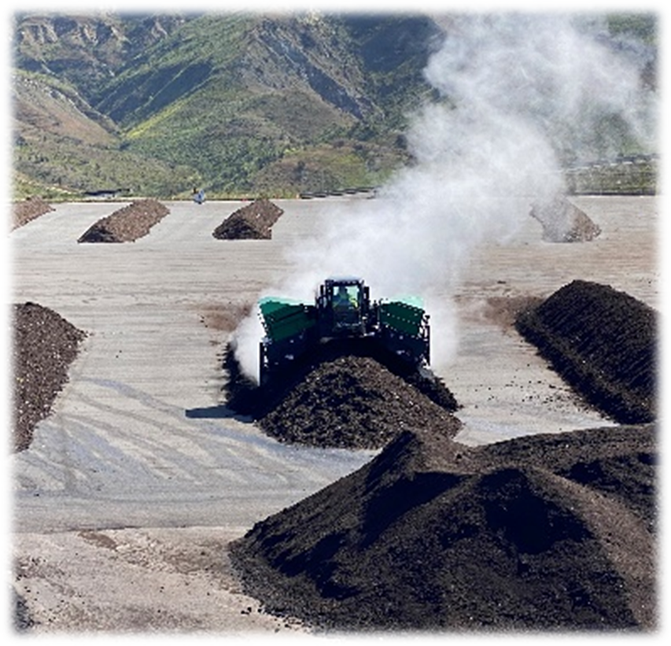
Future of Organic Waste in Orange County
Greeneries Established
Bee Canyon Greenery
Capistrano Greenery
Valencia Greenery
Implementation to Management
WISE Agreement
Program growth with sustainable compliance
Expand infrastructure planning
Steam from turning the green waste

Slide 13
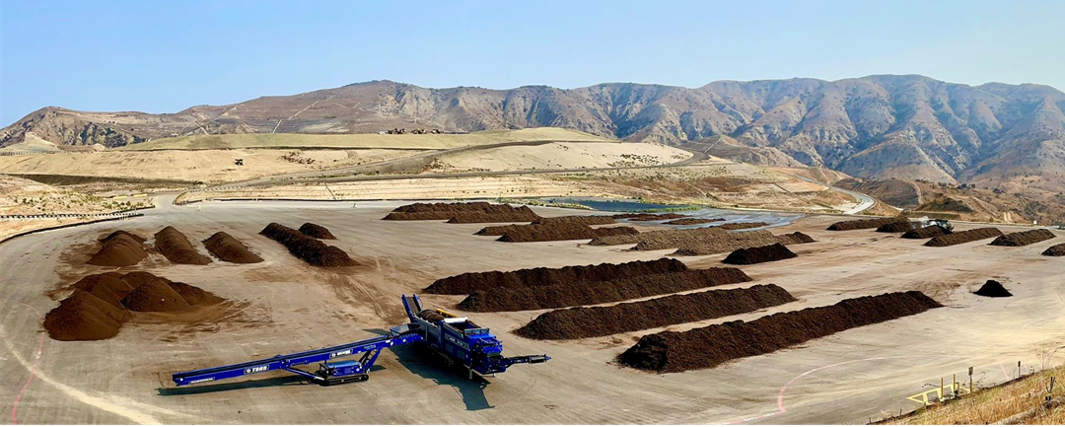
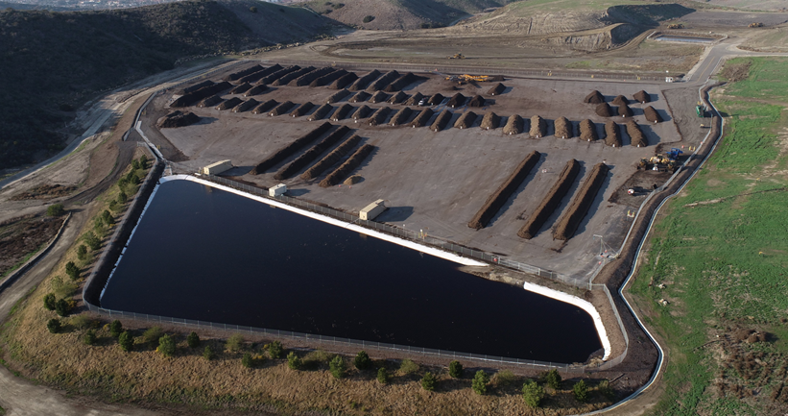
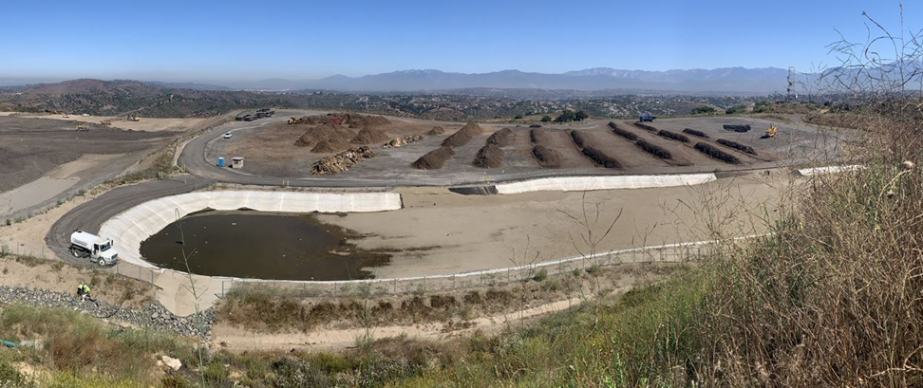
Future of Organic Waste Phase I Open Windrow Composting

Slide 14
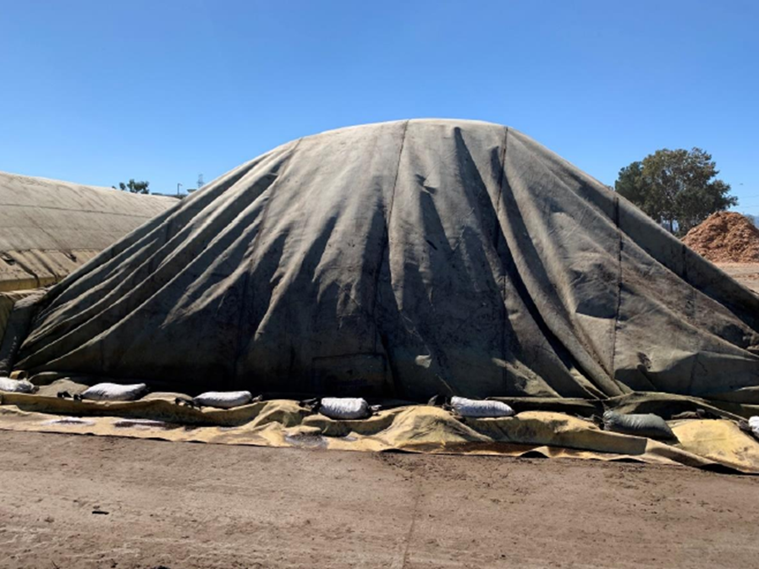
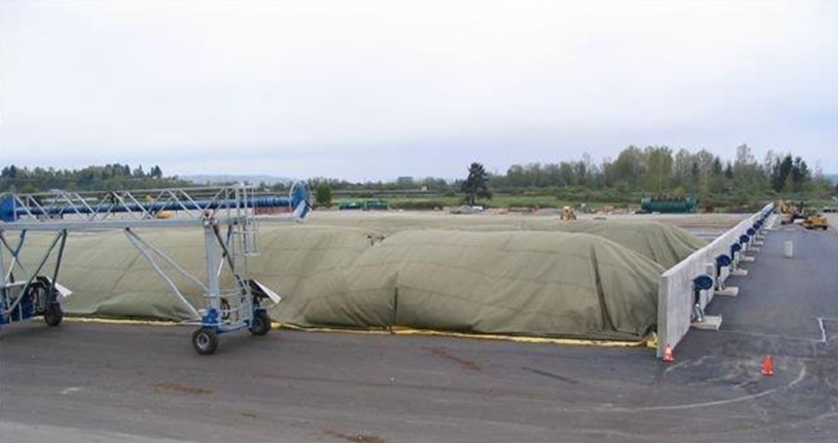
Future of Organic Waste Phase IB Covered Aerated Static Piles (CASP)

Slide 15
Future of Organic Waste Phase 2 Co-Digestion
Co-Digestion (Food Waste)
Use of existing capacity in Waste Water Treatment Plant (WWTP) (OC Sanitation District)
SSO processed to remove contamination, homogenize, direct inject into AD (OCWR Operations)
Benefits of increased digester efficiency
Biogas production increase & Biosolids destruction
Requires SSO (commercial program)
Requires volume (WDA)
Bridging Solid Waste and Wastewater Industries
Use of Conversion technology

Slide 16
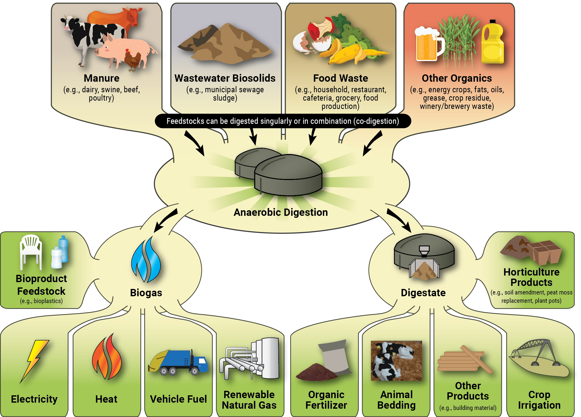
Future of Organic Waste Phase 3 Anaerobic Digestion
High Solids Anaerobic Digestion
Larger investment and infrastructure
Need for secure volume for long term (WDA)
Mass Balance
Gas, liquids and solids:
Provides RNG for pipeline/fuels/energy
Digestate liquids management
Biosolids for composting/land applications
Continuous process
Market driven by legislation and lack of infrastructure

Slide 17
Program Hurdles
Title 14 CCR, Compostable Materials Regulations
Conditional Use Permit/CEQA
CARB In-Use Off-Road Diesel-Fueled Fleets Regulations
SCAQMD Composting Rules, Rule 1133, 1133.1, 1133.2, 1133.3
State Water Board/Regional Water Quality Control Board
Construction General Permit
Industrial General Permit
Municipal Separate Storm Sewer System (MS4)
General Composting Order
Orange County Fire Authority Composting, Mulch and Organic Processing Guidelines
CalRecycle SB 901 Recycling and Disposal Reporting System (RDRS)
US Fish and Wildlife Service
Federal Endangered Species Act
Federal Migratory Bird Treaty Act
Section 10A, 404
CDFW Fish and Game Code
CDFA Food and Agricultural Code

Slide 18
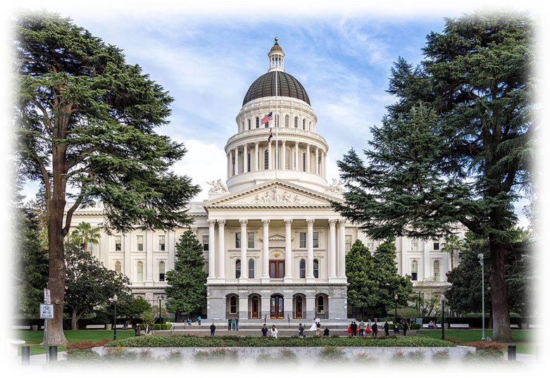
Future Needs
Organic Processing Facilities as Essential Public Facilities
Critical to meet the statewide organic diversion goals
Reduce the need to obtain emission reduction credits which are scarce and expensive
Permit Processing Coordination
Increase collaboration amongst permitting agencies
Reduce permitting timeframes
Support Local Market Development
CalRecycle and agencies can’t do it alone
Increase coordination amongst state and local agencies to promote organic product utilization

Slide 19
Questions?
Robert.Sedita@ocwr.ocgov.com

