Slide 1
ZWS Training 101
SB 1383 procurement solutions
September 25, 2019
CRRA Speaker series
Dec 14, 2023
Xinci Tan

Slide 2
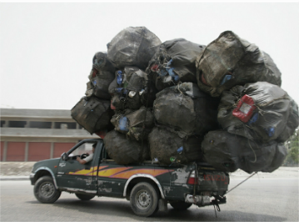
Zero Waste Sonoma – Joint powers authority (JPA)
Established in 1992
Serve and represent the 8 cities, 1 town, and County of Sonoma
5 pillars:
Household Hazardous Waste (HHW) facility and programs
Organics program
Zero Waste planning and policy
Public Education
Reporting
www.zerowastesonoma.gov

Slide 3
2022 Organics (food scraps and yard debris)
Residential = 83,428 tons
Commercial + debris box = 29,276 tons
Single-family accounts: 141,133
Multi-family accounts: 371
Commercial accounts: 3,354
Notes:
Organics Tonnage
RSM 2021: 18,692 tons commercial, 9949 tons debris box
SCRR 2022: 367 tons commercial, 6 tons MFD
SGC 2022: 262 tons
Organics Accounts
RSM 2021 year end: 3050 commercial, 299 MFD, 129,054 SFD
SGC 2022 year end: 77 commercial, 34 MFD, 4103 SFD
SCRR 2022 year end: 227 commercial, 38 MFD, 7976 SFD

Slide 4
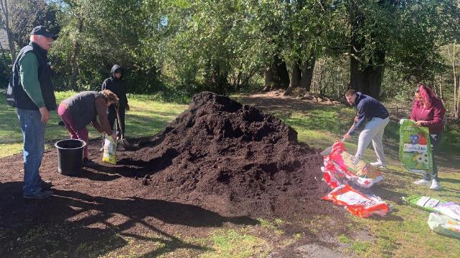
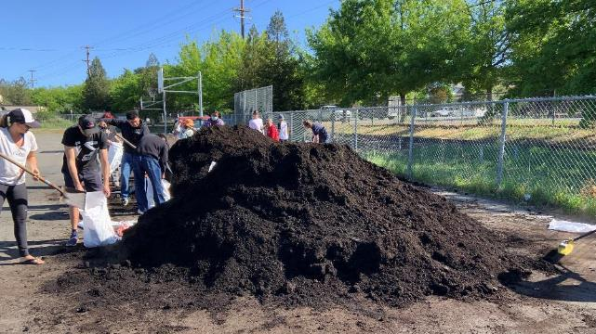
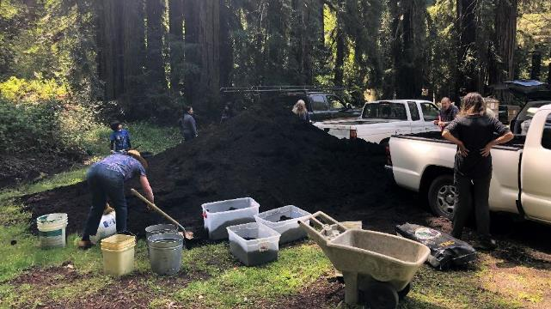
https://zerowastesonoma.gov/compost-giveaways

Slide 5
Procurement: Compost giveaways and carbon farming
1700 cubic yards – combined annual compost allotments part of contracts with three composting facilities
25 giveaway events + 10 donations in 2022
23 giveaway events + 17 donations in 2023
USDA Composting and Food Waste Reduction Pilot Project Grant $298,500
Carbon farming projects with Resource Conservation Districts
214 yards of compost given away

Slide 6
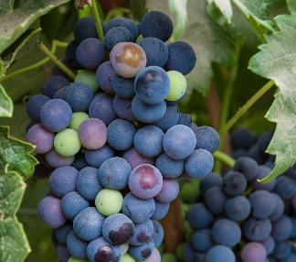
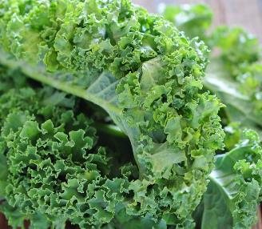
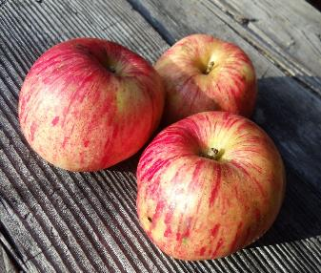
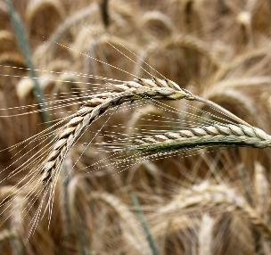
Concerns about procurement requirements
Strong agricultural sector + established market for compost = limited supply
Competition between jurisdictions and agricultural sector
Competition among jurisdictions

Slide 7
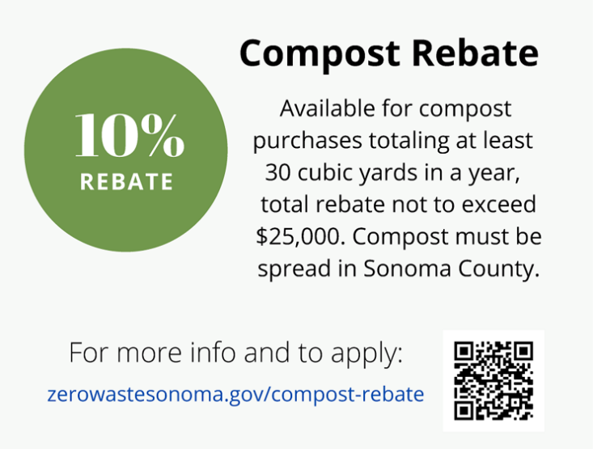
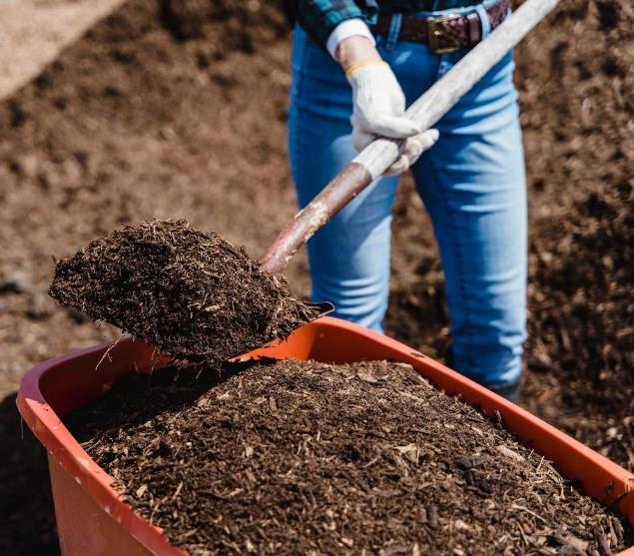

Slide 8
Compost rebate program
Developed with input and blessing from CalRecycle
Must sign rebate agreement before making purchase
10% rebate for combined purchases totaling >30 cubic yards in fiscal year (Jul-Jun)
Max claims in a fiscal year not to exceed $25,000 for any one entity
$150,000 budgeted for FY 23-24
Compost must be spread in Sonoma County
Rebate for cost of compost only (no derivatives like soil blends, transportation, or spreading)
Mulch will also be eligible product for rebate starting Jul 2023
Submit claims with copy of W-9 and receipts through online form
https://zerowastesonoma.gov/compost-rebate

Slide 9
Procurement progress 2023
20 active compost rebate agreements
5384 cubic yards of compost credited through rebate program ($13,622)
1,700 cubic yards of compost given away to residents
214 cubic yards of compost given away to farms/ranches
TOTAL = 7,298 cubic yards of compost toward procurement target
Countywide 100% procurement target = 56,168 cubic yards
In 2023, just need to achieve 30% procurement target = 16,850 cubic yards
We have so far achieved 13%

Slide 10
More compost not yet counted
Zero FoodPrint carbon sequestration
Daily Acts community composting/compost giveaways
Resource Conservation District projects ($300k+)
Hopeful that these additional efforts will get us close to the 30% procurement target for 2023

Slide 11
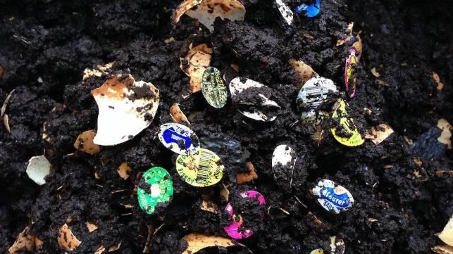
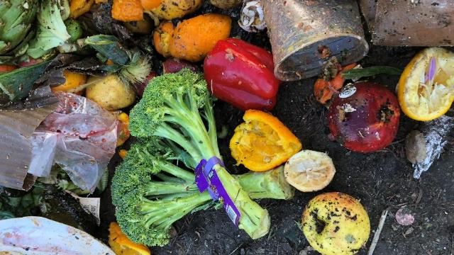
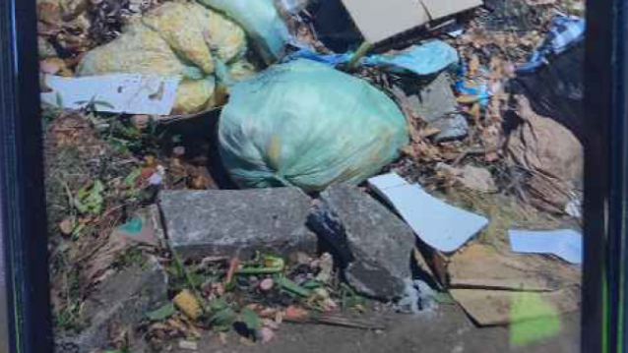
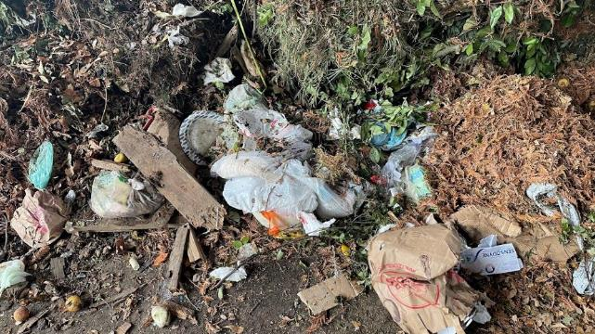

Slide 12
Questions?
Xinci Tan
Xinci.tan@Sonoma-county.org
(707) 837-6134

