Slide 1
The Zero-Emission Transition
Taylor York, Program Manager, Clean Cities Coalition Director
November 16, 2023

Slide 2
What are Clean Cities Coalitions?
Notes:
Shameless plug/establish credibility.

Slide 3
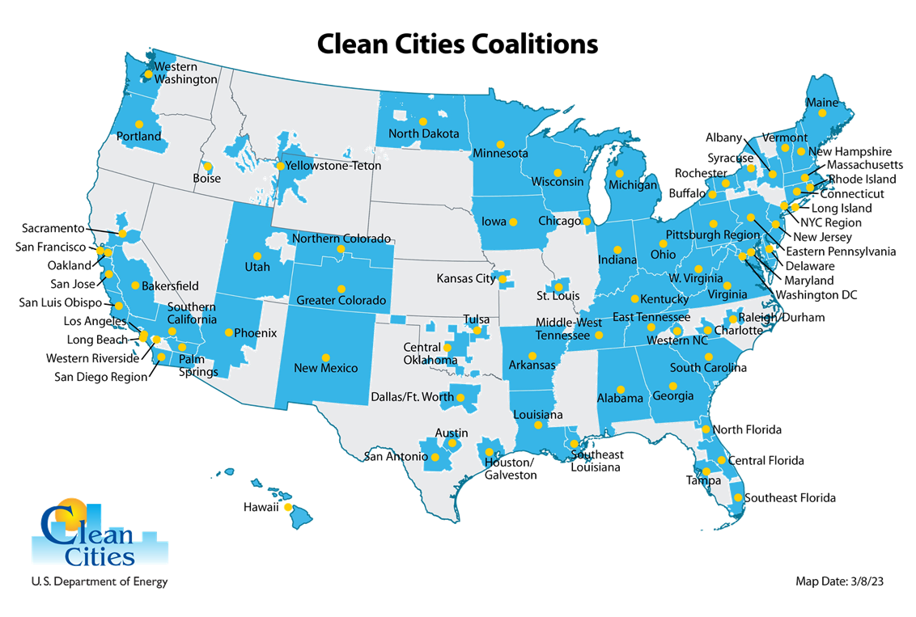
U.S Department of Energy, Vehicle Technology Office (VTO)
More than 75 active coalitions.
Goal: Help local decision-makers and fleets understand and implement clean fuels

Slide 4
Western Riverside County Clean Cities
Engagement, partnership building, technical support
Seek funding, focus investment in the IE, and communicate AQ challenges
Support the development of fueling and charging infrastructure
Support investment in ZEV vehicles and infrastructure
Ensure that the ZEV transition is economically feasible
Focus on workforce development - installation and maintenance

Slide 5
Policy is driving a transition to zero emissions.

Slide 6
Federal Clean Energy Goals
100% carbon pollution-free electricity (CFE) by 2030
100% percent zero-emission vehicle (ZEV) acquisitions by 2035
Net-zero emissions from federal procurement no later than 2050
A net-zero-emissions building portfolio by 2045
Net-zero emissions from overall federal operations by 2050
Most have more near-term goals

Slide 7
CA Governor’s Executive Order N-79-20
100% of in-state sales of new passenger cars and trucks ZEV by 2035
100% of medium and heavy-duty vehicles ZEV by 2045
100% of offroad vehicles and equipment, where feasible, by 2035

Slide 8
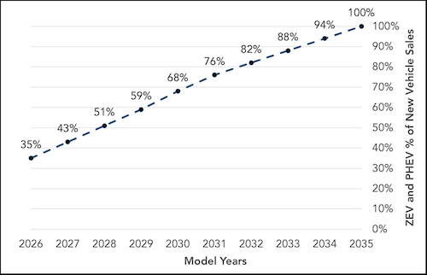
CA – Advanced Clean Cars II
All new passenger car, truck, and SUV sales in CA ZEV by 2035
Phased in - 35% ZEV sales by 2026, 68% by 2030, and 100% by 2035
Notes:
Going to cover 3 CA policies driving ZEVs

Slide 9
CA - Advanced Clean Trucks (ACT)
Class 2b to Class 8
Manufacturer sales requirement for MD and HD vehicles
Phased in approach to 2035
Notes:
Zero-emission truck sales: Manufacturers who certify Class 2b-8 chassis or complete vehicles with combustion engines would be required to sell zero-emission trucks as an increasing percentage of their annual California sales from 2024 to 2035. By 2035, zero-emission truck/chassis sales would need to be 55% of Class 2b – 3 truck sales, 75% of Class 4 – 8 straight truck sales, and 40% of truck tractor sales.
ompany and fleet reporting: Large employers including retailers, manufacturers, brokers and others are required to report information about shipments and shuttle services. Fleet owners, with 50 or more trucks, are required to report about their existing fleet operations. This information will help identify future strategies to ensure that fleets purchase available zero-emission trucks and place them in service where suitable to meet their needs.

Slide 10
CA - Advanced Clean Fleets (ACF)
*Slide content courtesy of the California Air Resources Board

Slide 11
CA - Advanced Clean Fleets (ACF)
Starting in 2036, all class 2b-8 sales in CA are ZEVs

Slide 12
CA - Advanced Clean Fleets (ACF)
January 1, 2024 – Newly added drayage trucks ZEV
January 1, 2025 – Must annually report mileage for trucks over 12 years
January 1, 2035 – All drayage trucks must be ZEV

Slide 13
CA - Advanced Clean Fleets (ACF)
State and Local Agencies
50% of vehicle purchases are zero-emission beginning in 2024. 100% of vehicle purchases are zero-emission by 2027. *Agencies in designated counties with 10 or fewer trucks are exempt until 2027.

Slide 14
CA - Advanced Clean Fleets (ACF)
Required % ZEVs | 10% | 25% | 50% | 75% | 100%
Milestone Group 1: Box trucks, vans, buses with two axles, yard tractors, light-duty package delivery vehicles | 2025 | 2028 | 2031 | 2033 | 2035+
Milestone Group 2: Work trucks, day cab tractors, buses with three axles | 2027 | 2030 | 2033 | 2036 | 2039+
Milestone Group 3: Sleeper cab tractors and specialty vehicles | 2030 | 2033 | 2036 | 2039 | 2042+

Slide 15
CA - Advanced Clean Fleets (ACF)
Reporting Dates:
Drayage (all legacy) - December 31, 2023
State and Local Government Fleets - April 1, 2024
High Priority Fleets - February 1, 2024
Fleet changes need to be reported within 30 days.

Slide 16
CA - Advanced Clean Fleets (ACF)
Resources:
ACF webpage: arb.ca.gov/our-work/programs/advanced-clean-fleets
ACF email: zevfleet@arb.ca.gov
Truckstop homepage: arb.ca.gov/truckstop
Hotline: 1-866-634-3735

Slide 17
Infrastructure & generation are critical
Notes:
Beyond the vehicles, infrastructure is a critical component.

Slide 18
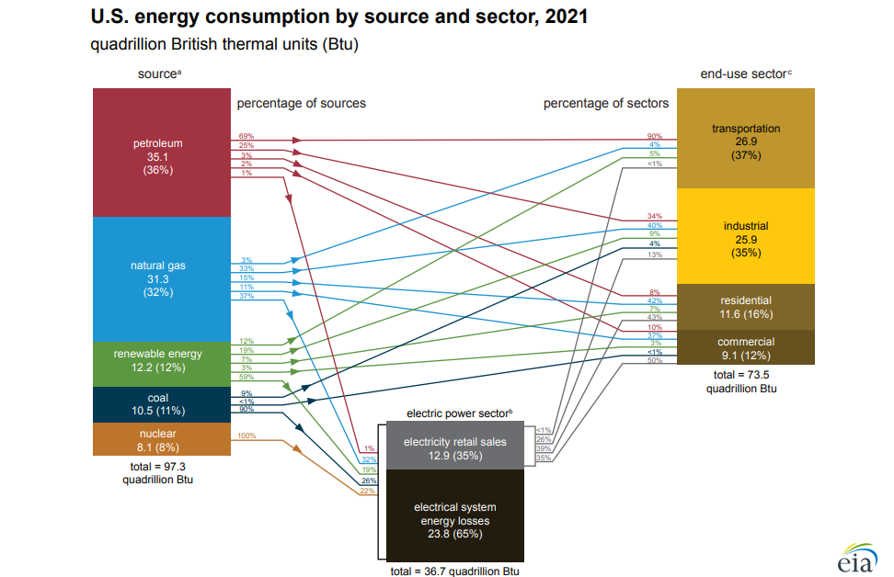
*US Energy Information Administration (https://www.eia.gov/energyexplained/us-energy-facts/images/consumption-by-source-and-sector.pdf)
Notes:
Transportation is a huge part of energy use.
A lot of the energy to power electric vehicles, comes from utilities and goes across the lines.

Slide 19
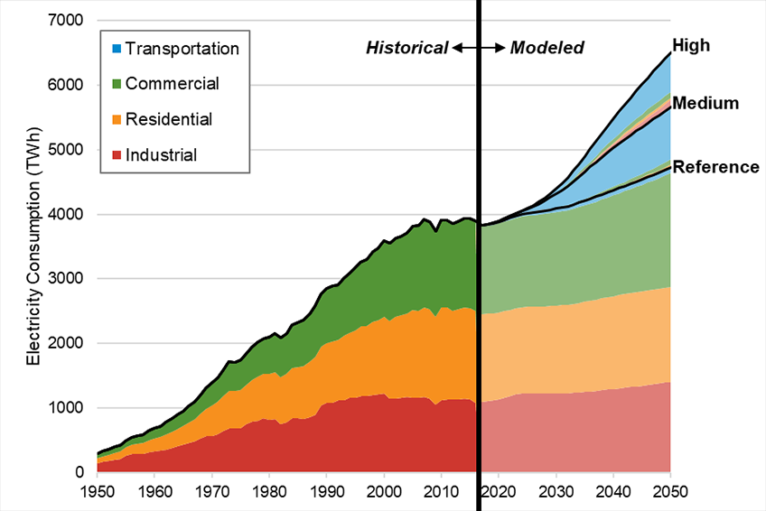
Electrification Demands
*National Renewable Energy Laboratory (https://www.nrel.gov/news/program/2018/analysis-demand-side-electrification-futures.html)
Notes:
You can see the drastic increase in electricity usage, especially in the transportation sector.
This is a chat prepared by the National Renewable Energy Laboratory (https://www.nrel.gov/news/program/2018/analysis-demand-side-electrification-futures.html)

Slide 20
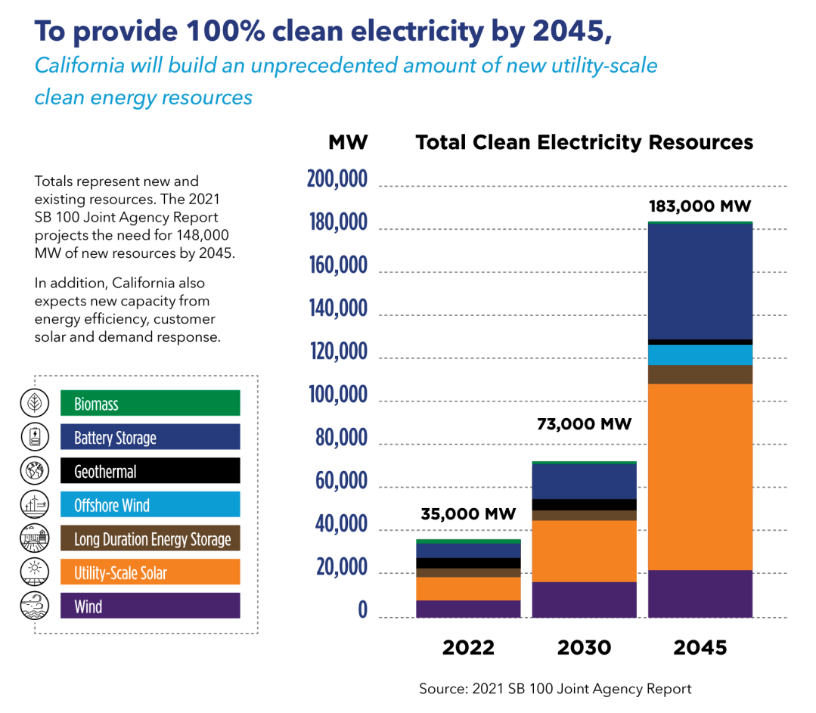
Notes:
Here you can see the projected need for clean electricity, and the different generation sources.
California will have to build 148,000 MW of new clean power by 2045.
100% clean energy by 2035.

Slide 21
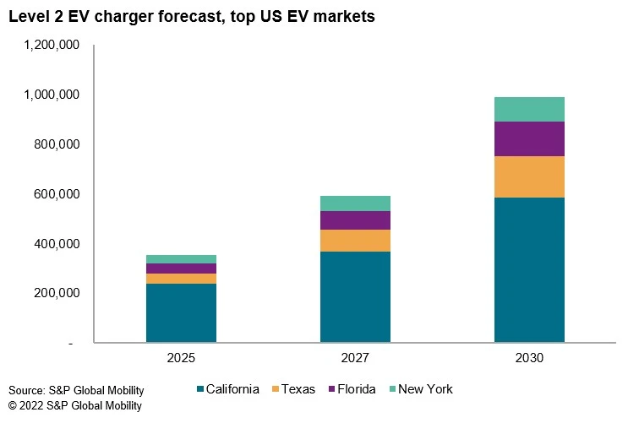

Slide 22
EVCS Permit Streamlining – AB 1237/970

Slide 23
FHWA – Alternative Fuel Corridors
Notes:
Talk about corridors
Talk about corridor nominations from WRCOG/partners

Slide 24
NEVI Program
National Electric Vehicle Infrastructure (NEVI) Formula Program
$5 billion Federal program, dedicated funding to states
CA - $384 million over 5 years
Interconnected network of DC fast chargers along the National Highway Systems
Money for charging network operators

Slide 25
Hydrogen Corridor Planning – H2LA
Hydrogen station planning along the Interstate 10 corridor, Houston to Port of Los Angeles
Partnership with Nikola, GTI Energy, other coalitions
Planning for deployment of H2 stations
Coalition role: local engagement

Slide 26
Operating ZEVs is different.
Notes:
The vehicles have to be available for sale, and fleets need to have relationships with the manufacturers and dealers.

Slide 27
Vehicles are different
HD vehicles have big batteries
Vehicles charge or fuel at varying rates, dependent on many factors
Weather can impact EV range significantly
Routes can impact performance and range significantly

Slide 28
The Fuels are Different
Source of electricity generation matters.
Hydrogen has big generation and transport considerations.

Slide 29
Yard Considerations
Large and fast vs. small and slow
On-site generation of H2 vs. trucked in fuel
Power available to serve the yard – charge management
Equipment maintenance and vandalism

Slide 30
Everyone will be involved.

Slide 31
Zero-Emission Transition Stakeholders
Fleets and operators
Manufactures and other industry
Installers, technicians
Fuel providers and station hosts
Utilities
Educational and training organizations
Federal, state, regional, and local agencies
Community members, including EEJ
Notes:
Fleets and operators
Acuiring, deploying, maintaining, operating, dealing with end of life
Manufactures (vehicles and infrastructure)
Building and selling vehicles
Installers, technicians
Fuel providers
Utilities
Educational and training organizations
Federal, state, regional, and local agencies
Community members, including EEJ

Slide 32
Transition requires training.
Notes:
If a transition to zero emissions is to be effective, we cannot focus only on how much is used, but also on how it is generated.
To take it even further, we need to think about the energy used to make the vehicles, make the technology that makes the power, and dispose of all of it at the end of its intended lifecycle.
These may seem like invisible things, but if not done correctly

Slide 33
Training and Education
Workforce training – transitioning to clean energy jobs
First responder training
Technician training
Fleet operations and driver behavior
Use case and duty cycle
Facilities design
Notes:
ZEVs are significantly different technologies, and they require many considerations.
Thinking about all of the different stakeholders.

Slide 34
Heavily impacted communities should help guide decisions.

Slide 35
SB 535 Disadvantaged Communities
Notes:
Highest CalEnviroscreen Scores
Target of significant amount of funding

Slide 36
Disproportionately Burdened Communities
Many are located along corridors and freight routes
High percentage in IE/LA Basin/Deserts
State and Federal funding targets these areas
ZEV transition can benefit these areas
Important to consider when deploying infrastructure and vehicles
Notes:
State Grants and Justice 40

Slide 37
Focusing Investment
CA Clean Mobility Options Pilot Program
Justice40 initiative
An Increasing number of funding opportunities must directly benefit EEJ
Building relationships with community organizations
Conducting direct engagement
Public fleet ZEVs focused operation in EEJ communities
Notes:
State Grants and Justice 40

Slide 38
Questions?

Slide 39
Thank you!
Taylor York, Program Manager
Clean Cities Coalition Director
tyork@wrcog.us

